Slide 1
NBC plastic litter incubations

Slide 2
Table 1. F statistics and p-values from linear mixed effects models. There were significant interactions between substrate and time only for gross metabolic assays and C processing enzyme potential, but not for other specific enzymatic and biofilm development assays. For all assays, time was a significant factor. There was a significant effect of substrate within crystal violet, but no interaction.

Slide 3
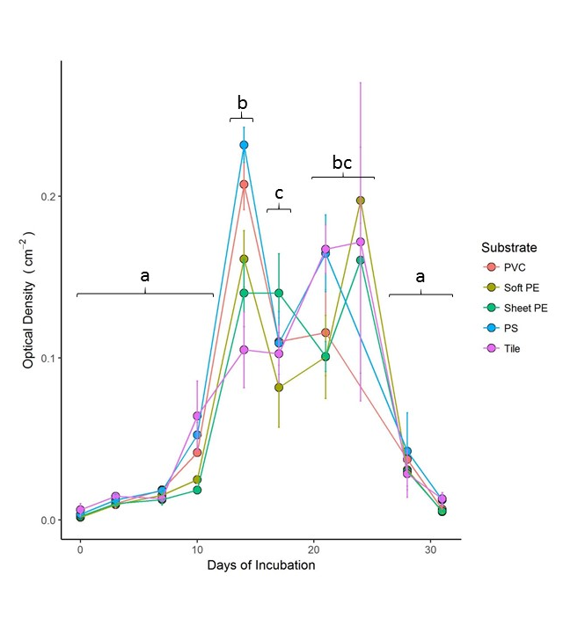
Figure 1. Crystal violet stain (biofilm size) rises and falls through the course of the incubation. Points are mean optical density grouped by substrate type. Error bars represent 1 standard error. Tukey contrasts with letters are between dates. There was a significant effect of substrate within the LME model, however, when one-way ANOVAs were performed by date and the p-values were corrected there were no longer significant differences between substrates. Biofilm size shows a clear acceleration between 10 and 15 days, a plateau, and then a marked decrease after day 25.

Slide 4
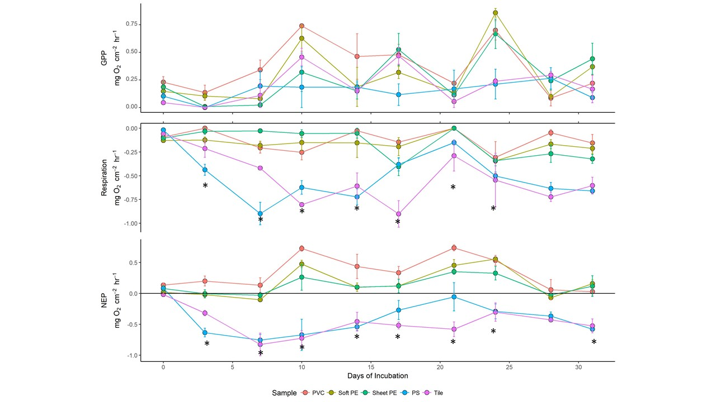
Figure 2. Gross metabolic assays on developing biofilms. Points are mean concentration grouped by substrate type. Error bars represent 1 standard error. Letters are Tukey contrasts from one-way ANOVAs within each sampling date. PS (polystyrene) and Tile seem to track together for respiration and consistently had more heterotrophic activity than the other materials. Many of the plastics sampled had net positive NEP whereas the natural analogue, tile, had negative NEP. This represents a major shift in ecosystem function when plastic substrates are present.

Slide 5
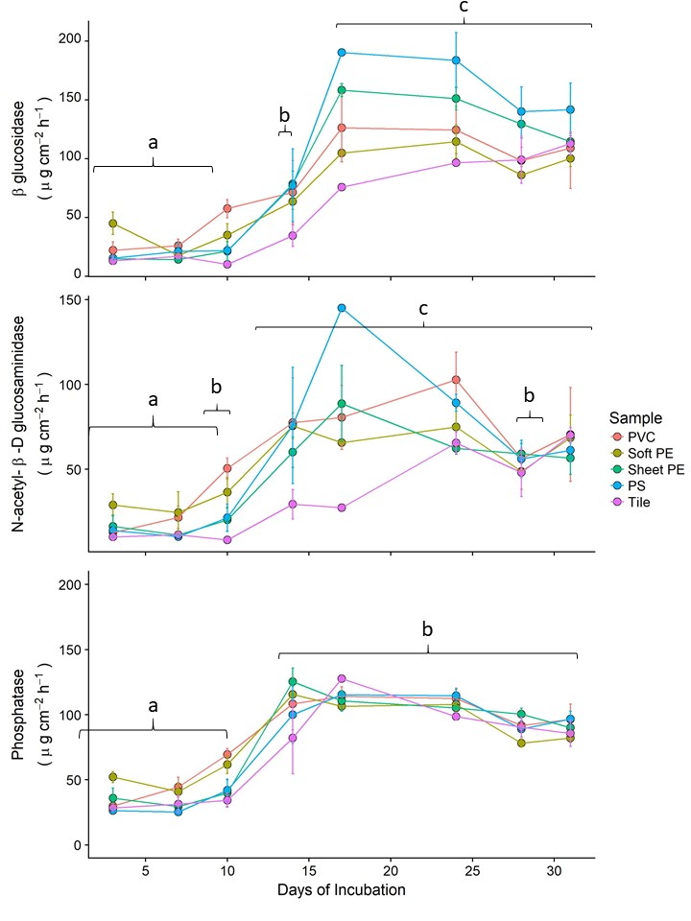
Figure 3. Enzymatic activity potential in river biofilms increases markedly between day 10 and 15. Points are mean concentration grouped by substrate type. Error bars represent 1 standard error. We did not observe any effect of substrate type on enzyme activity potential for NAG and P, but we did for BG. However, when one-way ANOVAs were performed by date and the p-values were corrected there were no longer significant differences between substrates. Tukey contrasts with brackets are between dates.

Slide 6
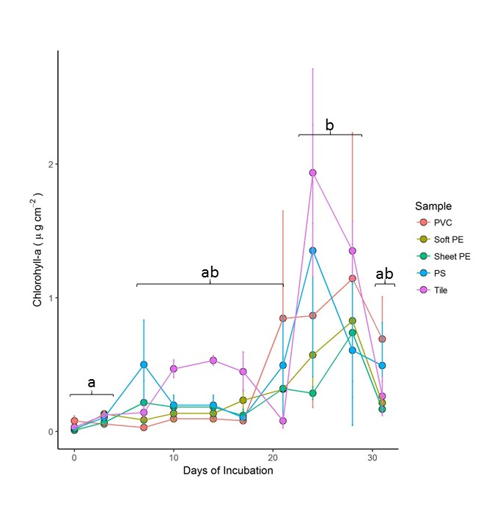
Figure 4. Chlorophyll concentration remained low for the majority of the incubation and only rose after day 20. Points are mean concentration grouped by substrate type. Error bars represent 1 standard error.

Slide 7
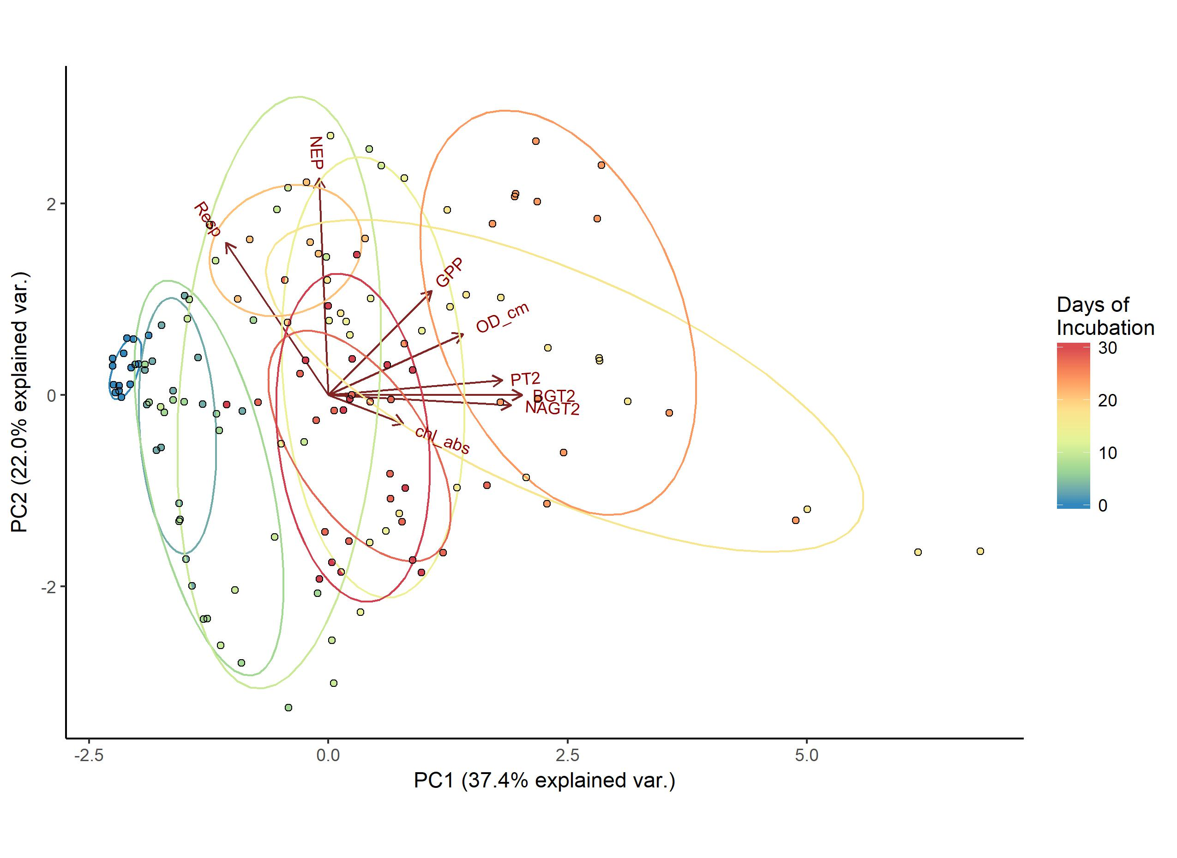
Figure 5. Principal component biplot for principal components 1 and 2 (Table 2). Colored groupings are colored by date of sampling. Ellipses are normal contours.

Slide 8
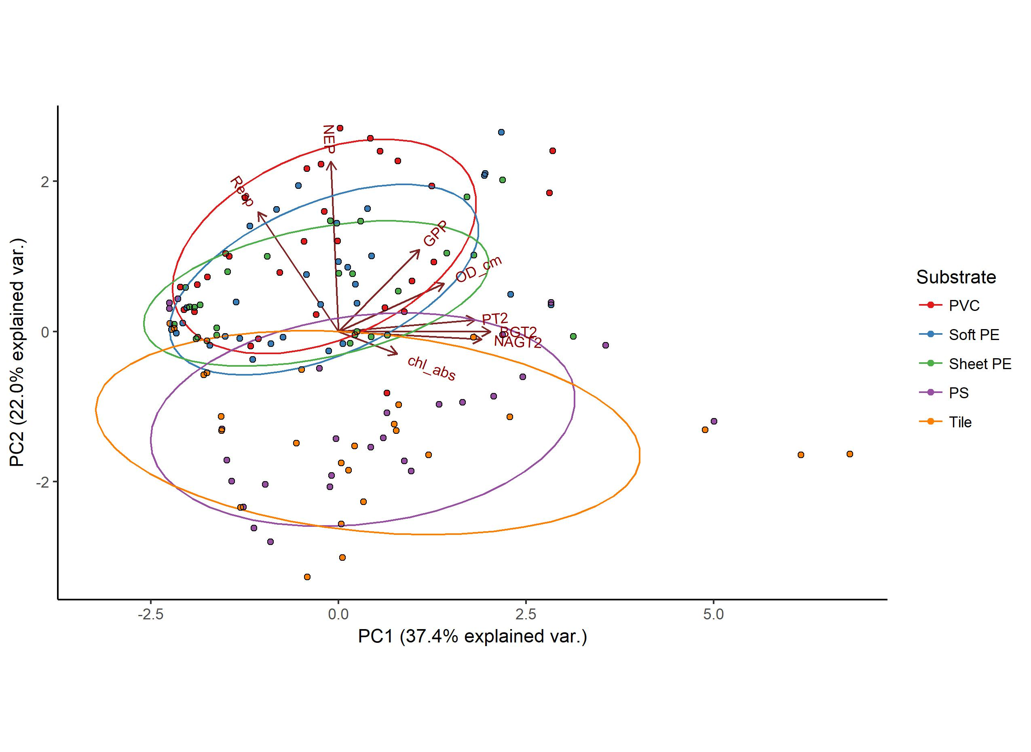
Figure 6. PCA biplot with points grouped by substrate. Tile and (PS) Styrofoam clearly differentiate from all materials along PC2.

Slide 9
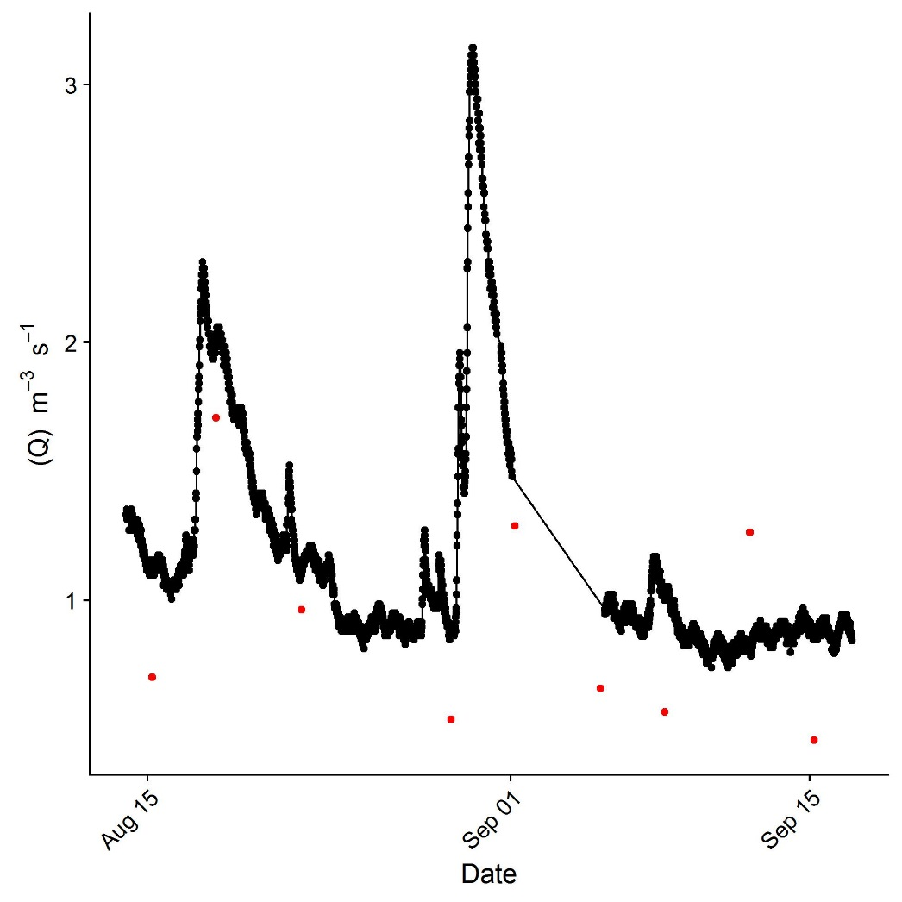
Black points are USGS gauge at Niles (3.44mi downstream)
Red bars are field observations of discharge at site

